Slide 1
Distributed Industrial Control Systems Security
Decentralized Security Design in Industrial Control Systems
By: Adam Spanier, Brevin Wagner, Kendra Herrmann, Matthew Popelka, and Perry Donahue
Notes:
- Adam

Slide 2
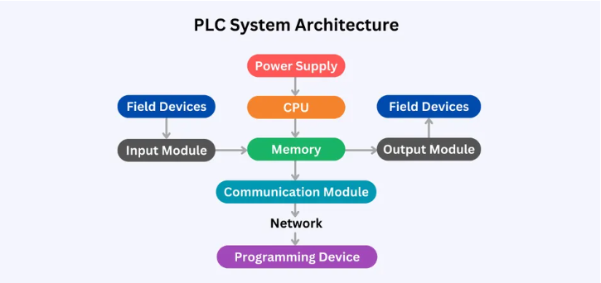
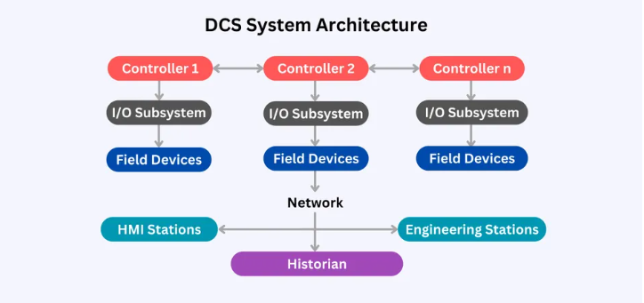
Background Information
History of PLC and DCS
What are PLC and DCS
Security challenges with existing DCS systems
Real-world risks to compromised DCS systems
Existing security solutions and the need for improvements
Figure 1: Waseem, U. (2024, August 13). Difference between plc and dcs: Decoding the automation divide. https://www.wevolver.com/article/difference-between-plc-and-dcs
Figure 2: Waseem, U. (2024, August 13). Difference between plc and dcs: Decoding the automation divide. https://www.wevolver.com/article/difference-between-plc-and-dcs
Notes:
- Kendra

Slide 3
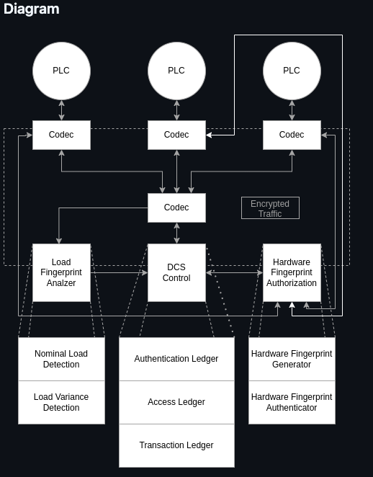
Executive Project Summary
Research focus and key question
Novel Decentralized Security
The need for improved DCS security solutions
Project goals and objectives:
Data Collection
System Design
System Emulation
Analysis and Reporting
Project benefits
Notes:
- Adam

Slide 4
Project Timeline
Phase | Duration | Description
Python Environment Setup | 1 Week | Determine whether to use an existing Python repository (SCADASim, Cpppo) or develop a custom environment. Ensure uniform environment variables and dependencies across all machines for uniform results.
Simulation Environment Deployment | 2 Weeks | Install and test the simulation environment on each team member's computer. Verify consistency across deployments to establish a standard setup.
Novel DCS Design | 3 Weeks | Design a secure Distributed Control System (DCS) using cryptographic functions, based on literature reviews and baseline setups.
Implement DCS Design in Python Environment | 2 Weeks | Develop and integrate cryptographic security features into the Python-modeled DCS using programmatic classes and functions.
Testing the Emulated DCS | 2 Weeks | Conduct tests on the Python-emulated DCS environment. Analyze and note successes and failures. Make necessary adjustments to improve security effectiveness for failed results.
Final Report | 3 Weeks | Document the entire project, including successful implementations, failures, and recommendations for future research and improvements.
Notes:
- Matt

Slide 5
Project-oriented Risk List
Risk name (value) | Impact | Likelihood | Description
Limited academic research on specific PLC vulnerabilities (64) | 8 | 8 | This project hinges on expanding upon previous academic research; if there is not a sufficient amount of research, it could hamper the project.
Constrained testing environments (64) | 8 | 8 | Any testing done on PLC's will be on virtual devices, this could create constraints.
Inability to simulate real-world attack scenarios (48) | 8 | 6 | The project will culminate with a simulation of cryptography working on a PLC, simulation could be an issue.
Difficulty obtaining comprehensive attack surface data (48) | 6 | 8 | The team needs to know what they are protecting in order to attempt to protect it, if this cannot be obtained, it will hamper the project's path forward.
Challenges in demonstrating practical exploits (42) | 7 | 6 | The team will not have access to physical PLC's for testing, this could present challenges in simulation and demonstration.
Hardware-level security limitations (42) | 6 | 7 | Due to testing being completed on virtual devices, there will be limitations in what can be completed on them.
Time management challenges (42) | 6 | 7 | All of the members of this team are also full-time employees, it will take good time management to complete the necessary pieces of this project.
Notes:
- Kendra

Slide 6
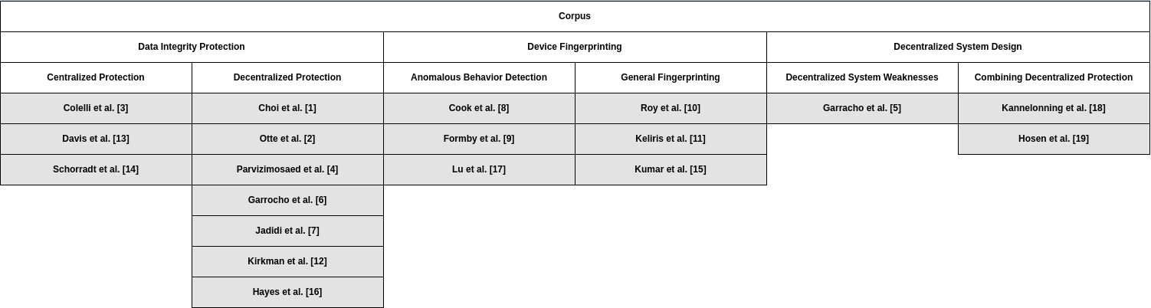
Project Methodology – Literature Review
Blockchain in Industrial Control Systems
Centralized vs. Decentralized Approaches
Biometric security use cases in industrial control systems
Limited research on decentralized ICS design
Three key publications in decentralized system design
Notes:
- Adam

Slide 7
Project Methodology – Technical Review
Project technical plan purpose
Technical plan four-phase approach:
Phase 1: Data Collection
Phase 2: System Design
Phase 3: Novel System Emulation
Phase 4: Analysis and Reporting
Notes:
- Matt

Slide 8
Resources Needed
Resource | Dr. Hale needed? | Investigating Team member | Description
Intrusion Prevention Systems (IPS) | No | All | Monitors network traffic for potential threats and automatically blocks them by terminating dangerous connections, removing malicious content, or triggering other security devices.
Emulation Program using Python | Maybe | All | We will be using a program written in Python to emulate a distributed system once we reach the testing phase. There are multiple github repo's to choose from, one will be chosen according to ease of use and need.
Team Member's Time | No | All | Appropriate time blocks will need to be set for all team members to ensure the appropriate distribution of work.
Previous Study Literature | No | Adam | A study of previous studies done on DSS will need to occur to gather the requisite literature to assist in planning and carrying out this project.
GitHub Project Tracking | No | All | Appropriate project tracking is necessary, so utilizing the GitHub project tracking capabilities will be required.
Decentralized Cryptographic System | No | All | This system will be assembled from the combined set of all decentralized security controls gleaned from the threat/asset list.
UNO Library Resources | No | All | Using the resources provided in the UNO library allows for review of other related research and topics to further assist with the knowledge of PLC's and Distributed Systems.
Notes:
- Brevin

Slide 9
Sprint Plan – Python-Based Simulation Deployment & Novel DCS Design
Sprint Goals
Develop, test, and deploy Python simulation environment
Design a preliminary DCS design with cryptographic functions
Sprint Plan Duration
4 weeks
Week | Description | Acceptance Criteria
Week 1 | Determine Python Environment Setup | Decision on environment setup; Standardized dependencies
Week 2 | Deploy Python Simulation Environment (Part 1) | Environment installed and runs on all team members’ machines
Week 3 | Deploy Python Simulation Environment (Part 2) | Uniform simulation output; Deployment documentation complete
Week 4 | Design Novel DCS | Initial design created; DCS meets baseline project expectations
Notes:
- Perry

Slide 10
Questions and Feedback?
Notes:
- Perry

